Slide 1
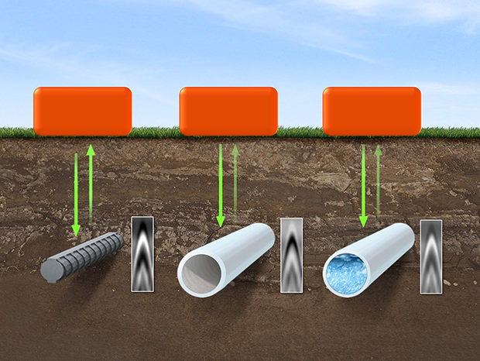
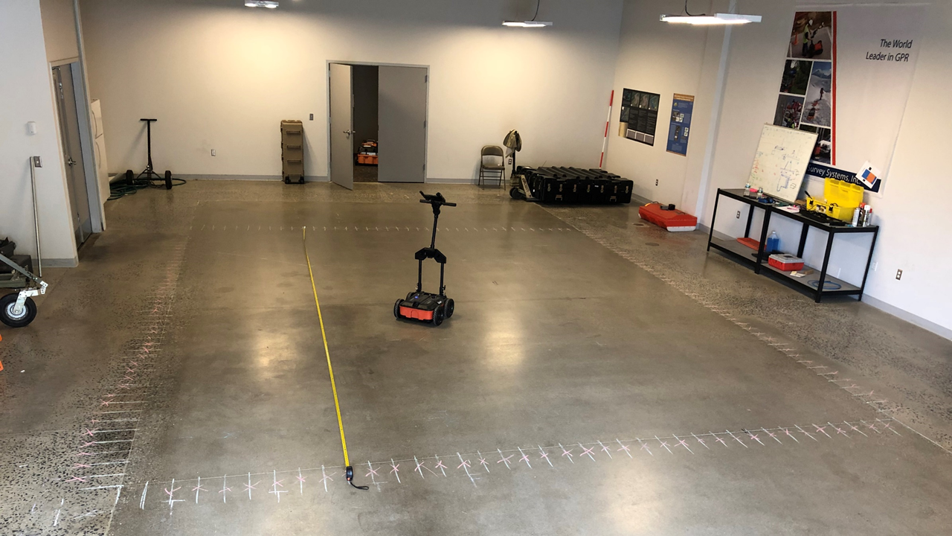
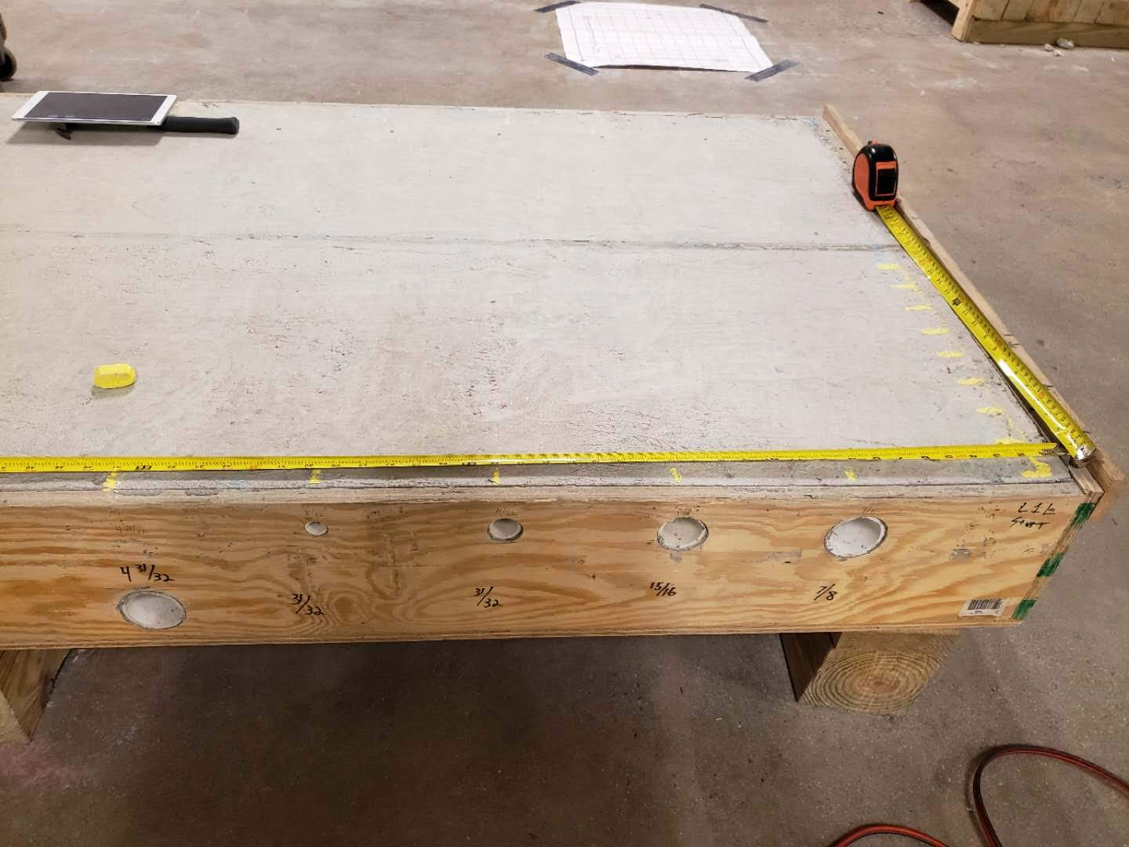
GPR-based Model Reconstruction System for Underground Utilities Using GPRNet
Jinglun Feng
Robotics Lab, City College of New York

Slide 2
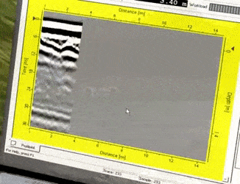
GPR Introduction
What is GPR?
Ground Penetration Radar
How it works?
EM Wave, Two-way travel time
Why GPR?
None-Destructively Testing (NDT)
Notes:
The GPR method is a wave propagation technique that transmits a pulse of polarized high-frequency radar waves into the subsurface media. EM wave attenuates as it travels in media and reflects when it encounters a material change. GPR antenna would thus record the strength and traveled time of each reflected pulse.

Slide 3
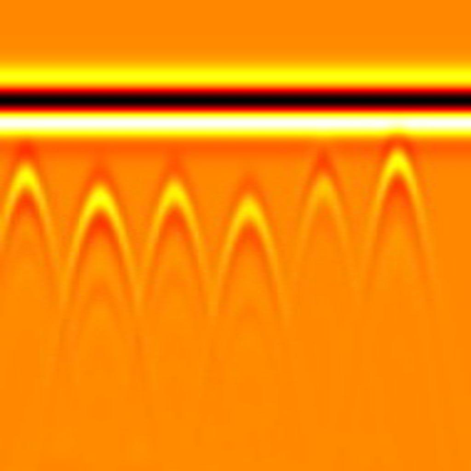
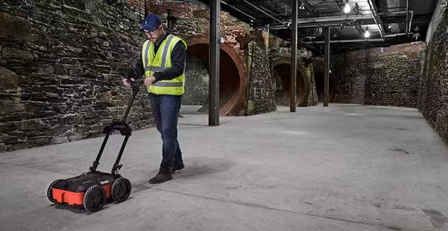
GPR Preliminary and Challenges
$$O^{}$$
$$x$$
Direct
Coupling
$$time$$
B-Scan Hyperbola
B-Scan Raw Data
Consecutive Scan
A-Scan Raw Data
GPR Background Noise Data
Unknow Subsurface Dielectric
Inefficient and Tideious GPR Data Collection
Hard Interpretation and Abstract Visualization
GPR Migration: The mathematical-based technique which serves as the traditional GPR imaging tools, enabling to convert the unfocused raw B-scan radargram data into a focused target
？
GPR Background Noise
Notes:
GPR works by sending a pulse of polarized high-frequency electromagnetic (EM) wave into the subsurface media. EM wave attenuates as it travels in media and reflects when it encounters a material change. GPR antenna would thus record the strength and traveled time of each reflected pulse. The received signal is called an \emph{A-scan}. When GPR antenna surveys over a subsurface object, it produces a series of A-scans at different positions, and the ensemble of A-scans forms a \emph{B-scan}. The B-scan contains the hyperbolic feature which would indicate the location of the target.

Slide 4
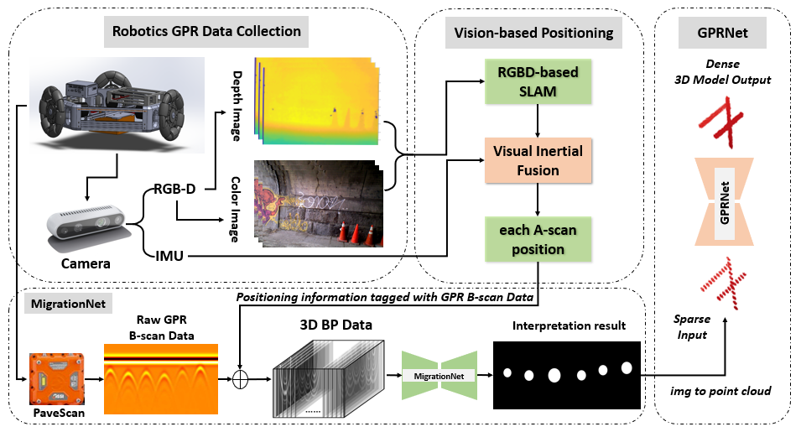
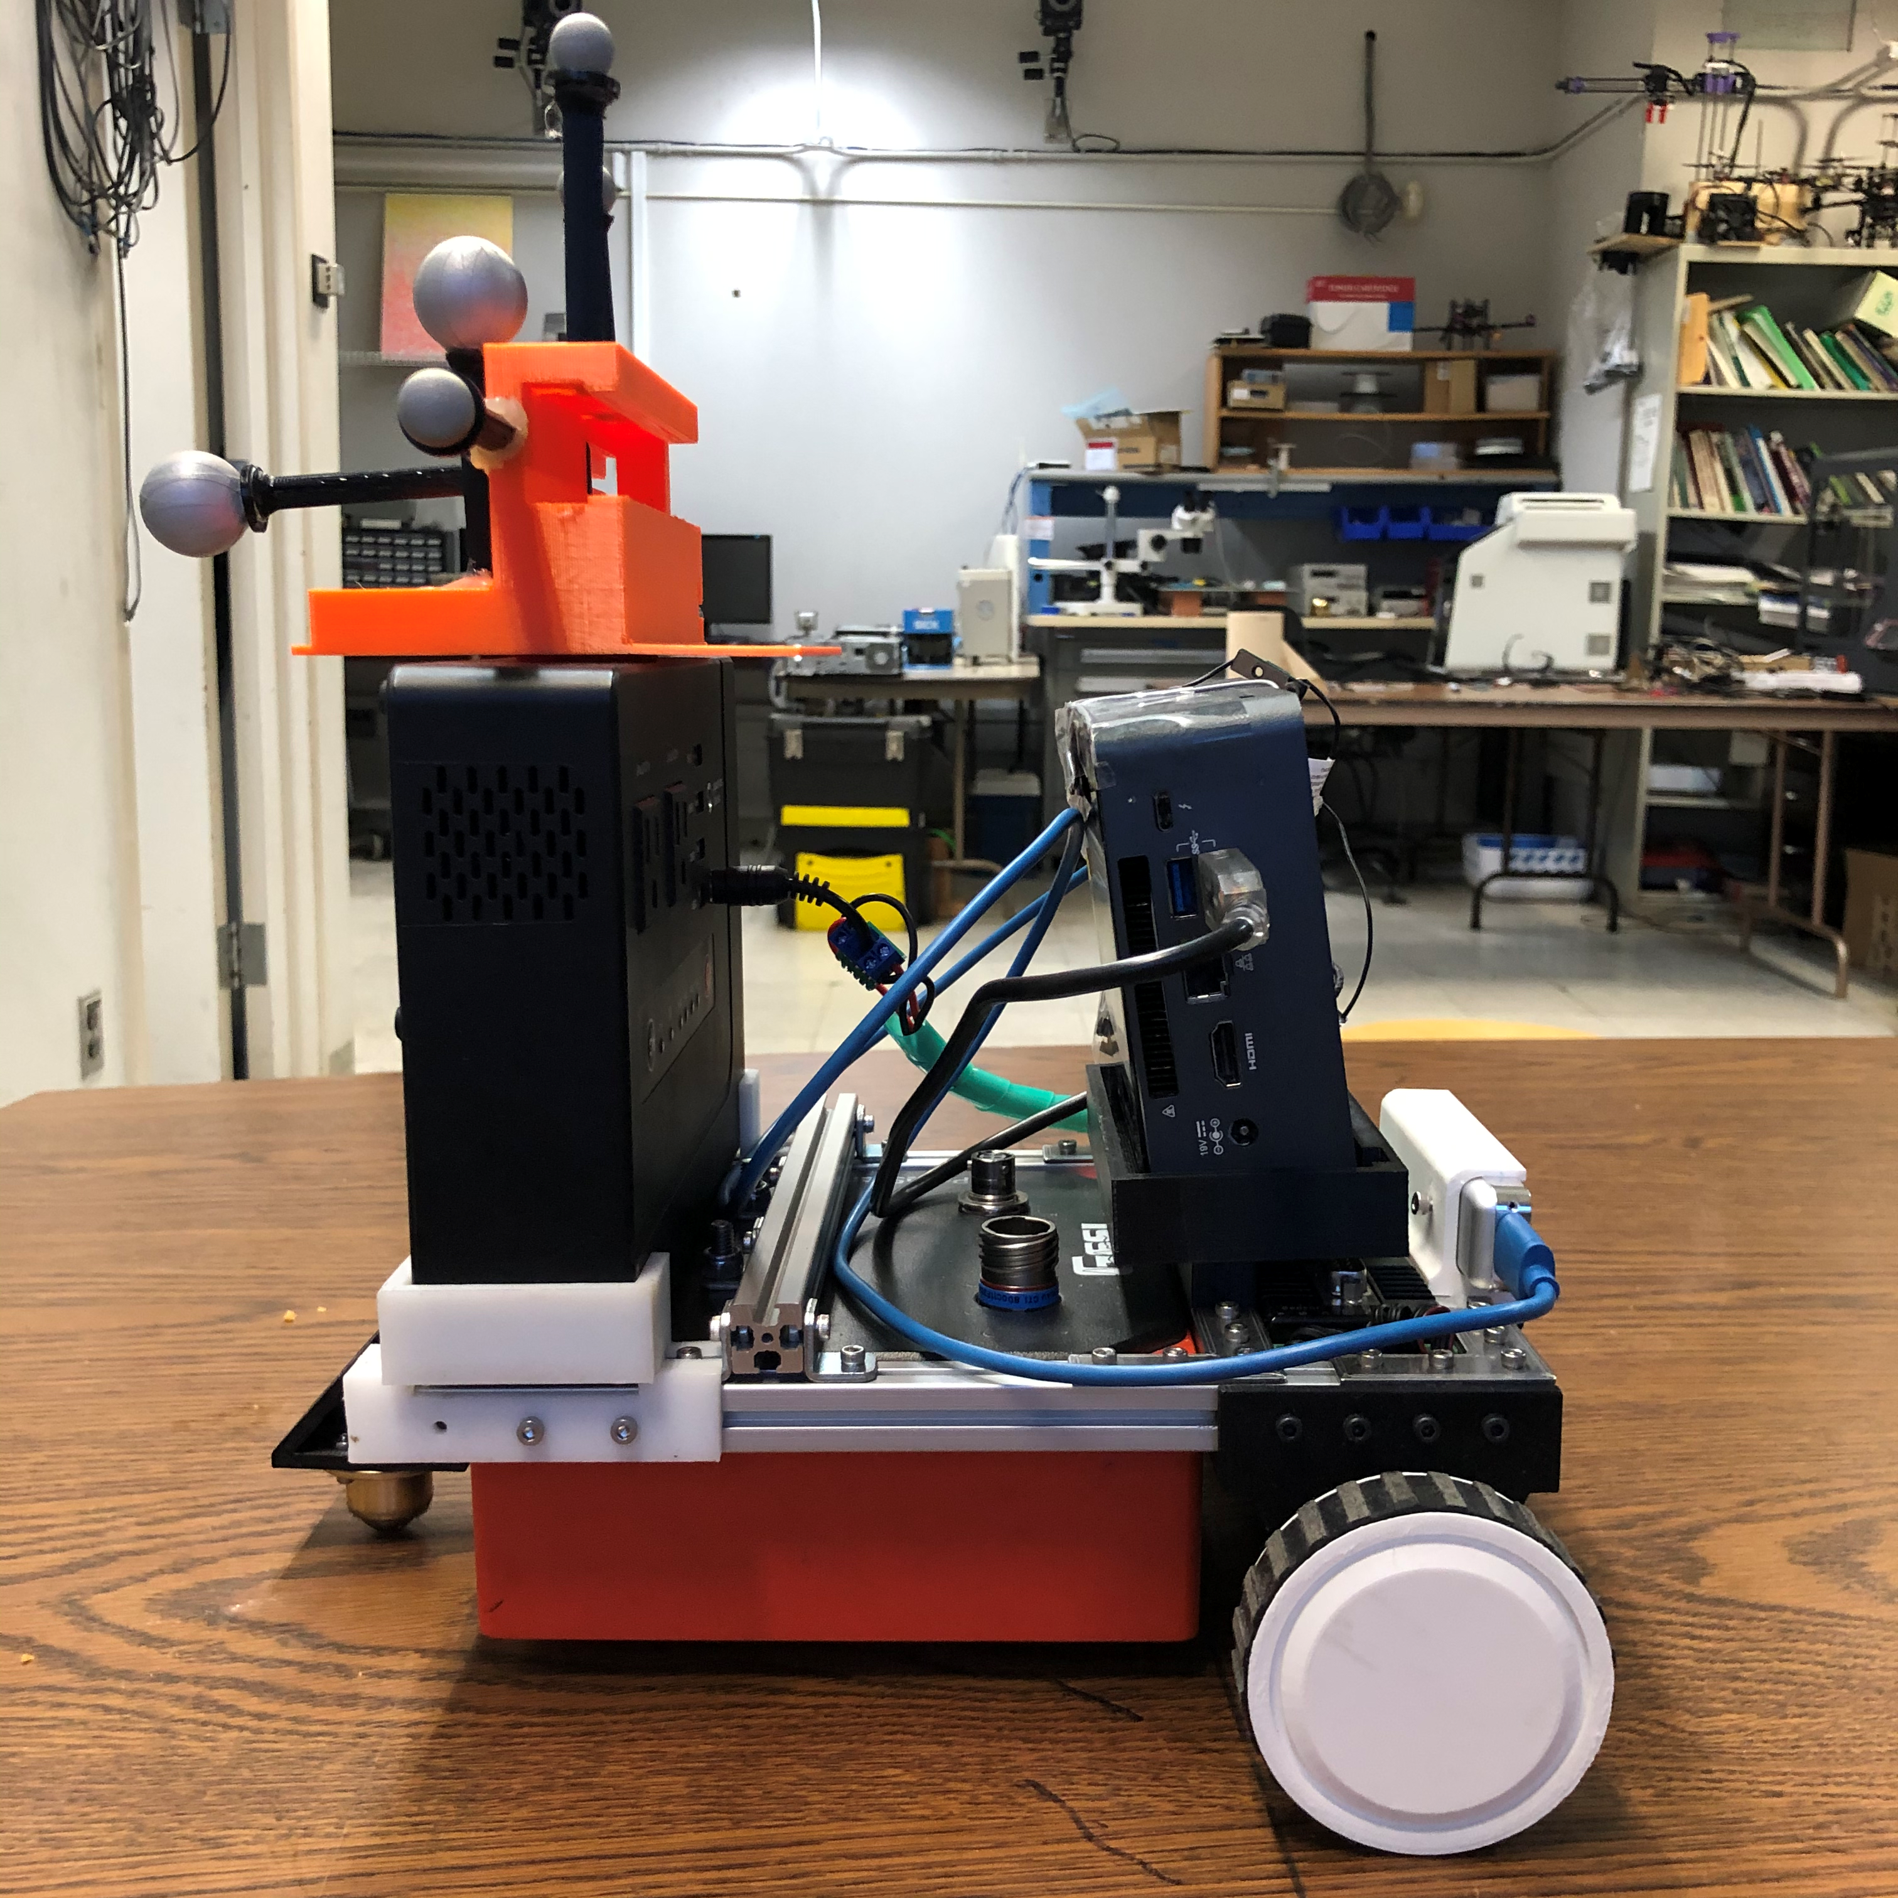
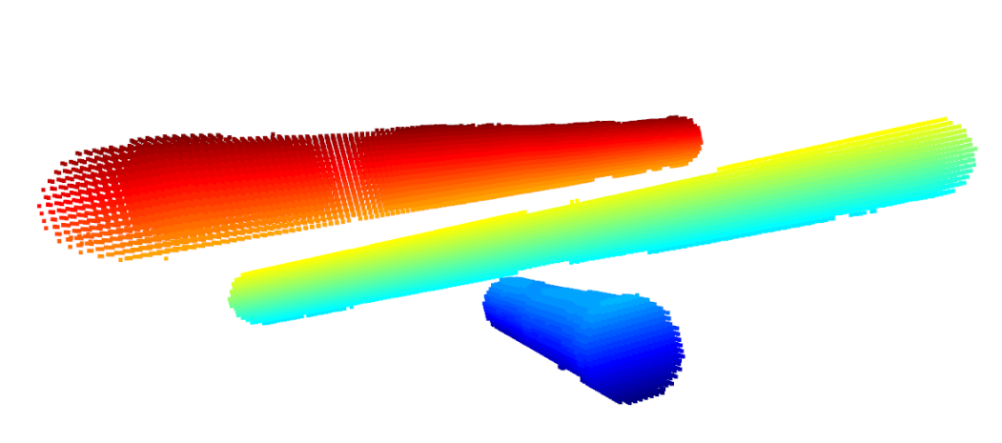
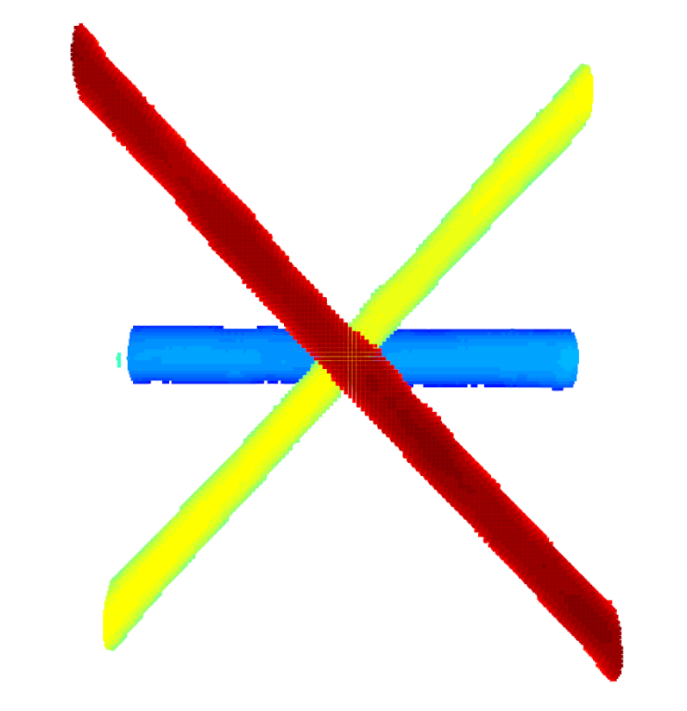
Motivations
Goal:
A robot which can automatic collect GPR data and reconstruct 3D model of underground cylinder objects
Automatic GPR Inspection
GPR Background Noise Data
Unknow Subsurface Dielectric
Manually GPR Data Collection
Hard Interpretation and Abstract Visualization
Remove GPR Background Noise Data
Estimate Unknow Subsurface Dielectric
Automatic GPR Data Collection
Intuitive Interpretation and Fridenly Visualization

Slide 5
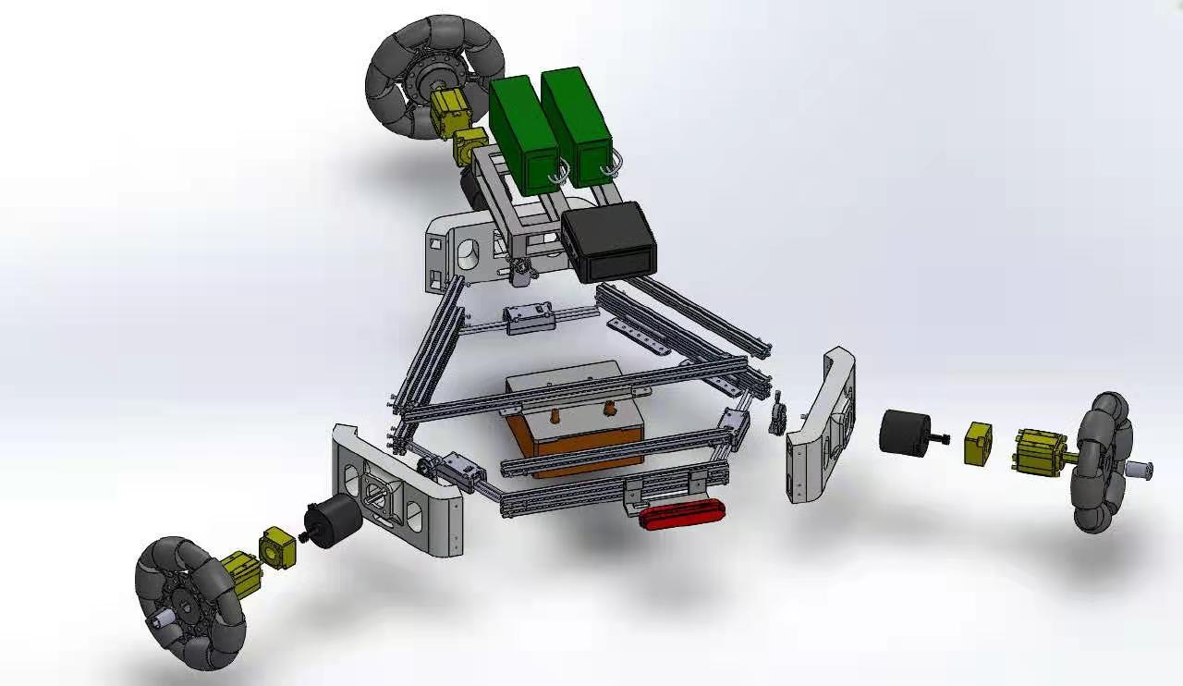
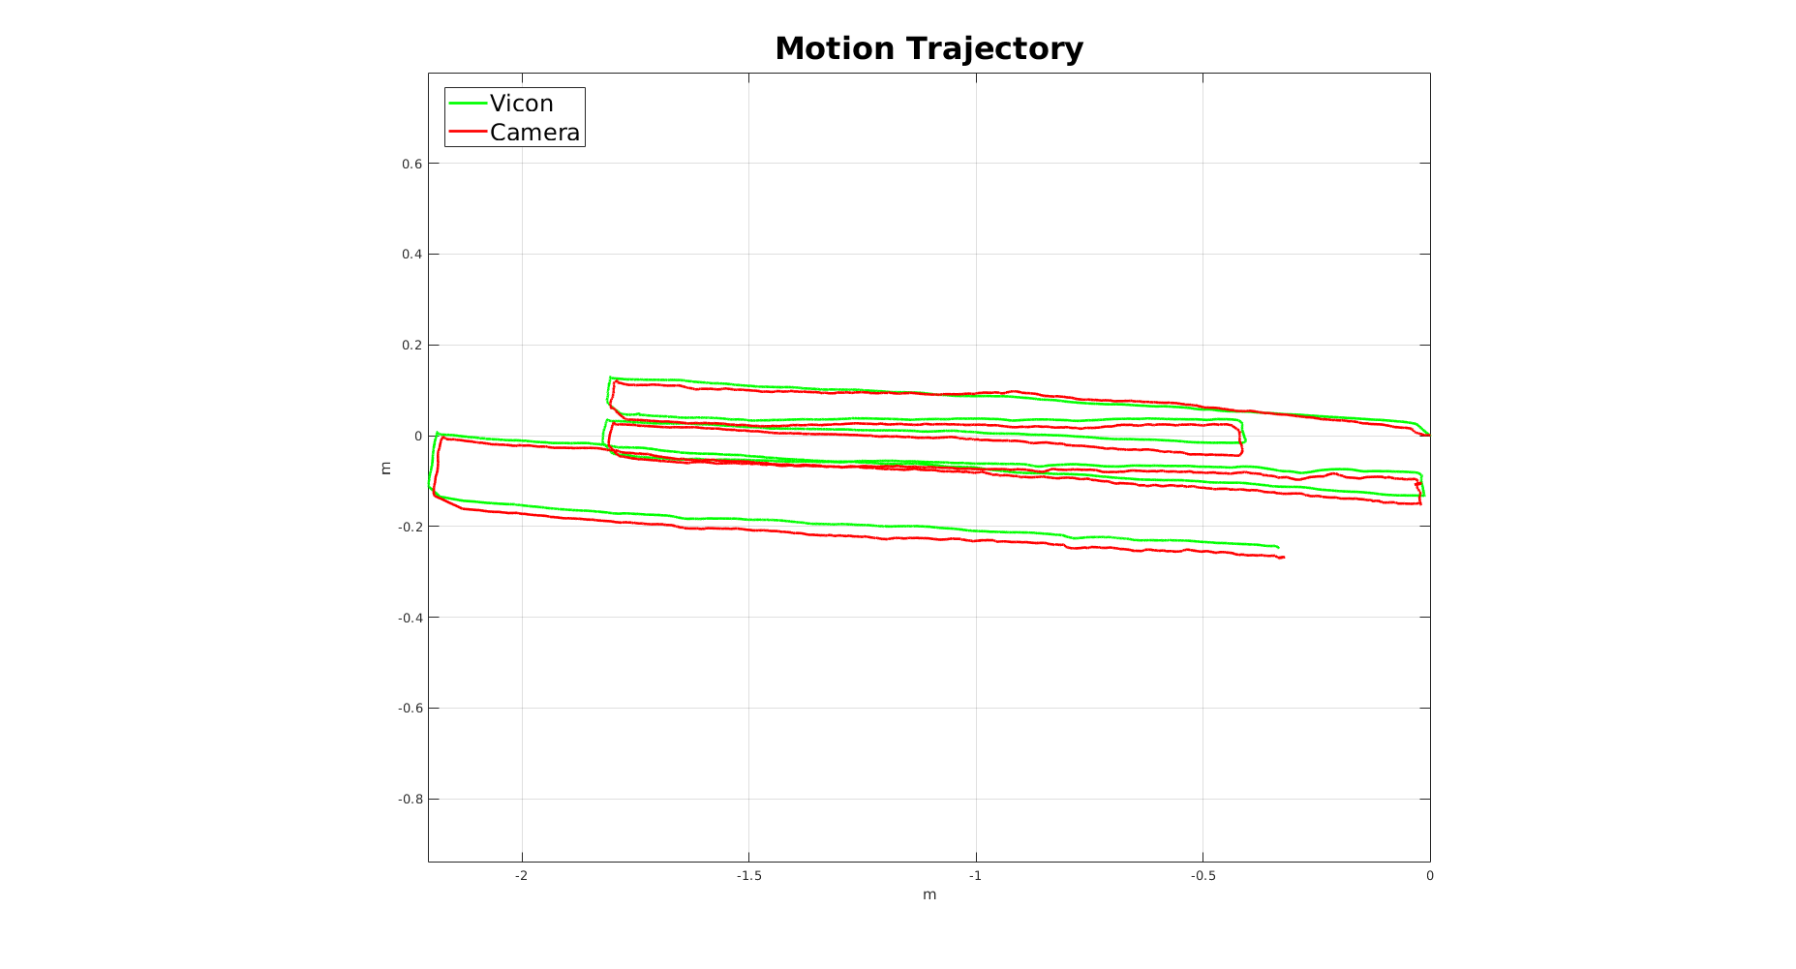
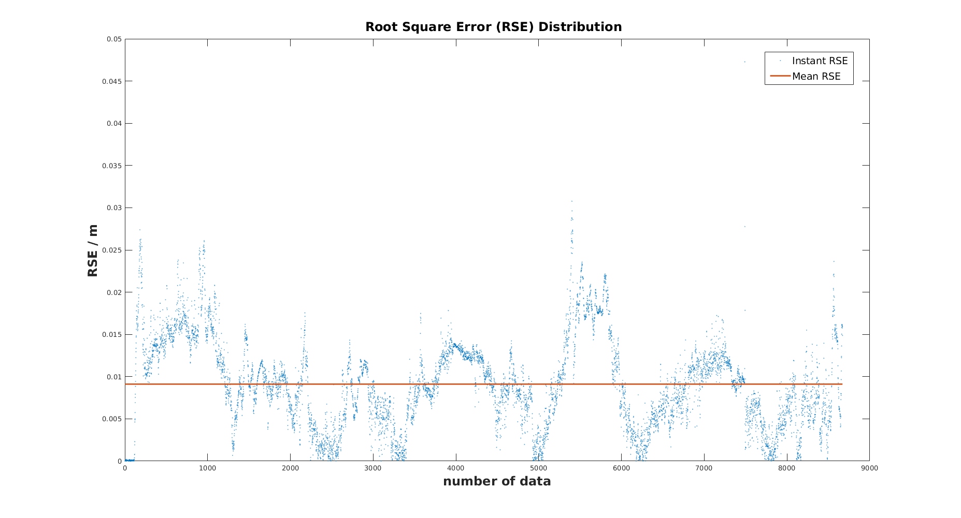
Omni-GPR-Cart Platform
Battery
Intel NUC
$$\left[\begin{matrix}v_{w1_drv} \\ v_{w2_drv} \\ v_{w3_drv}\end{matrix}\right]=\left[\begin{matrix}1 & 0 & −d \\ \cos{\frac{2π}{3}} & \sin{\frac{2π}{3}} & −d \\ \cos{\frac{−2π}{3}} & \sin{\frac{−2π}{3}} & −d\end{matrix}\right]$$
GSSI GPR
$$\left[\begin{matrix}v_{x} \\ v_{y} \\ ω\end{matrix}\right]$$
Motion Model:
RealSense Camera

Slide 6
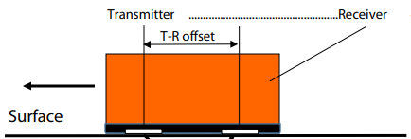
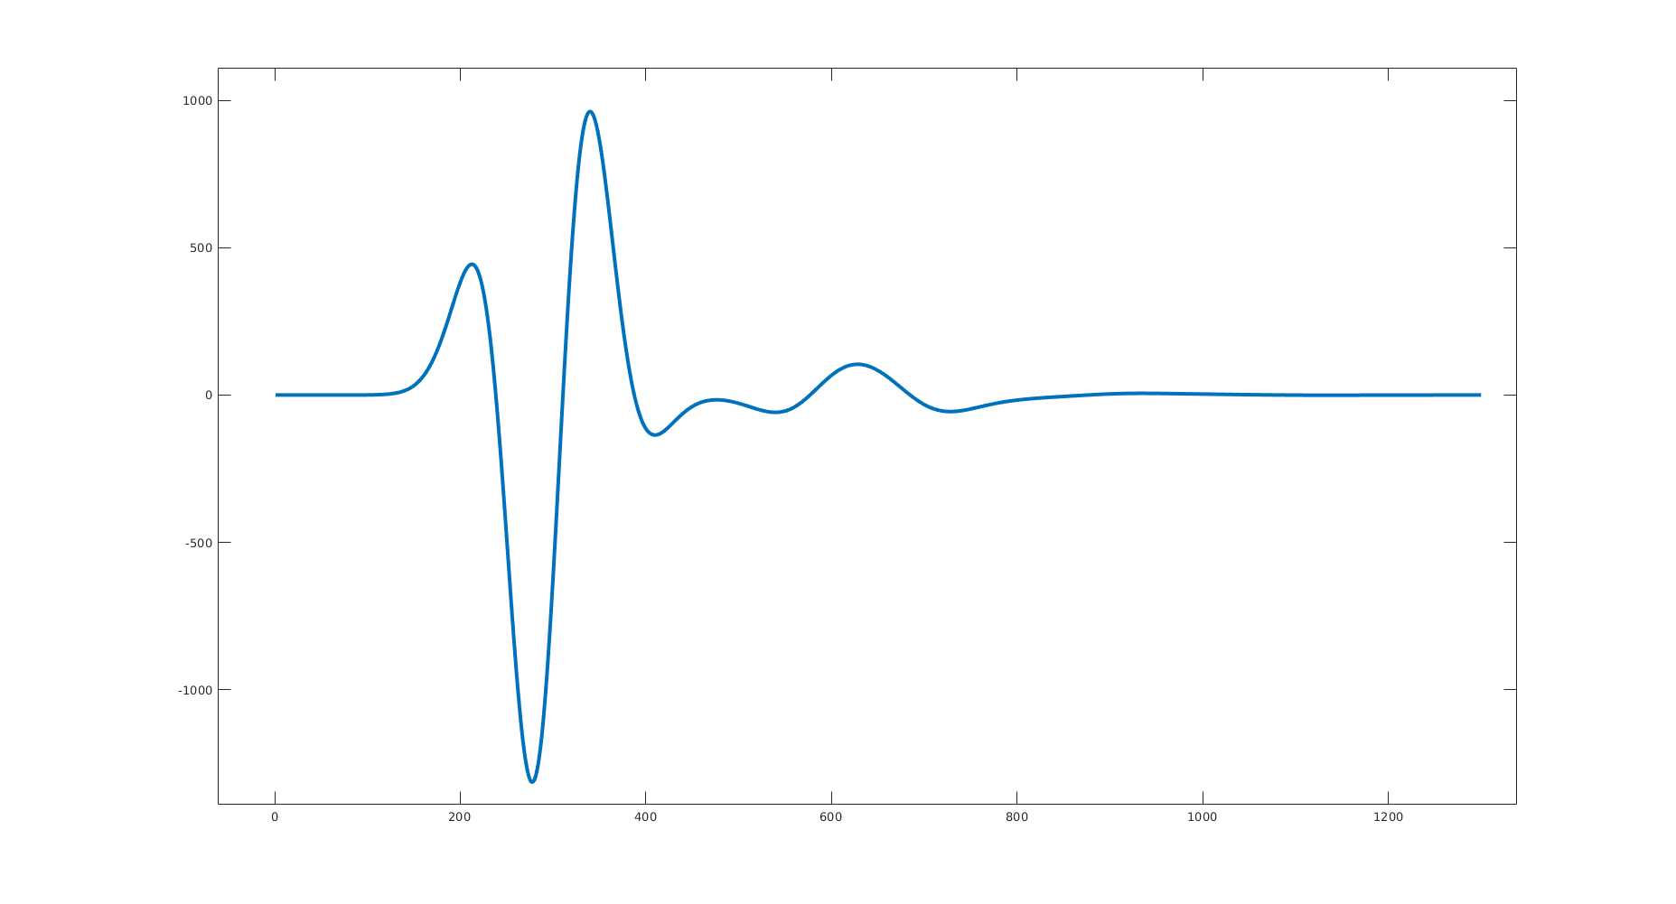
Conventional GPR Imaging Algorithm
Back Projection
A-Scan Raw Data
$$∀A_{q}^{k}∈B_{k}, {\left(x−a\right)}^{2}+{\left(y−b\right)}^{2}={\left.{\left(a\right.}_{t}∗t\right)}^{2}, y<0$$
$$\left.A_{q}^{k}= \{a_{t}|t=1,…,n_{q}\right\}$$
$t$: traveling time
: the $q$-th A-scan measurement in $k$-th B-scan data
$a_{t}:$amplitude of A-scan signal
$$\left.B_{k}= \{A_{q}^{k}|q=1,…,n_{k}\right\}$$
: the $k$-th B-scan consisting of $n_{k}$ A-scans
$n_{q}:$the total samples in a A-scan measurement

Slide 7
Conventional GPR Imaging Algorithm
“The brighter the intersection, the more possible an object exists”

Slide 8
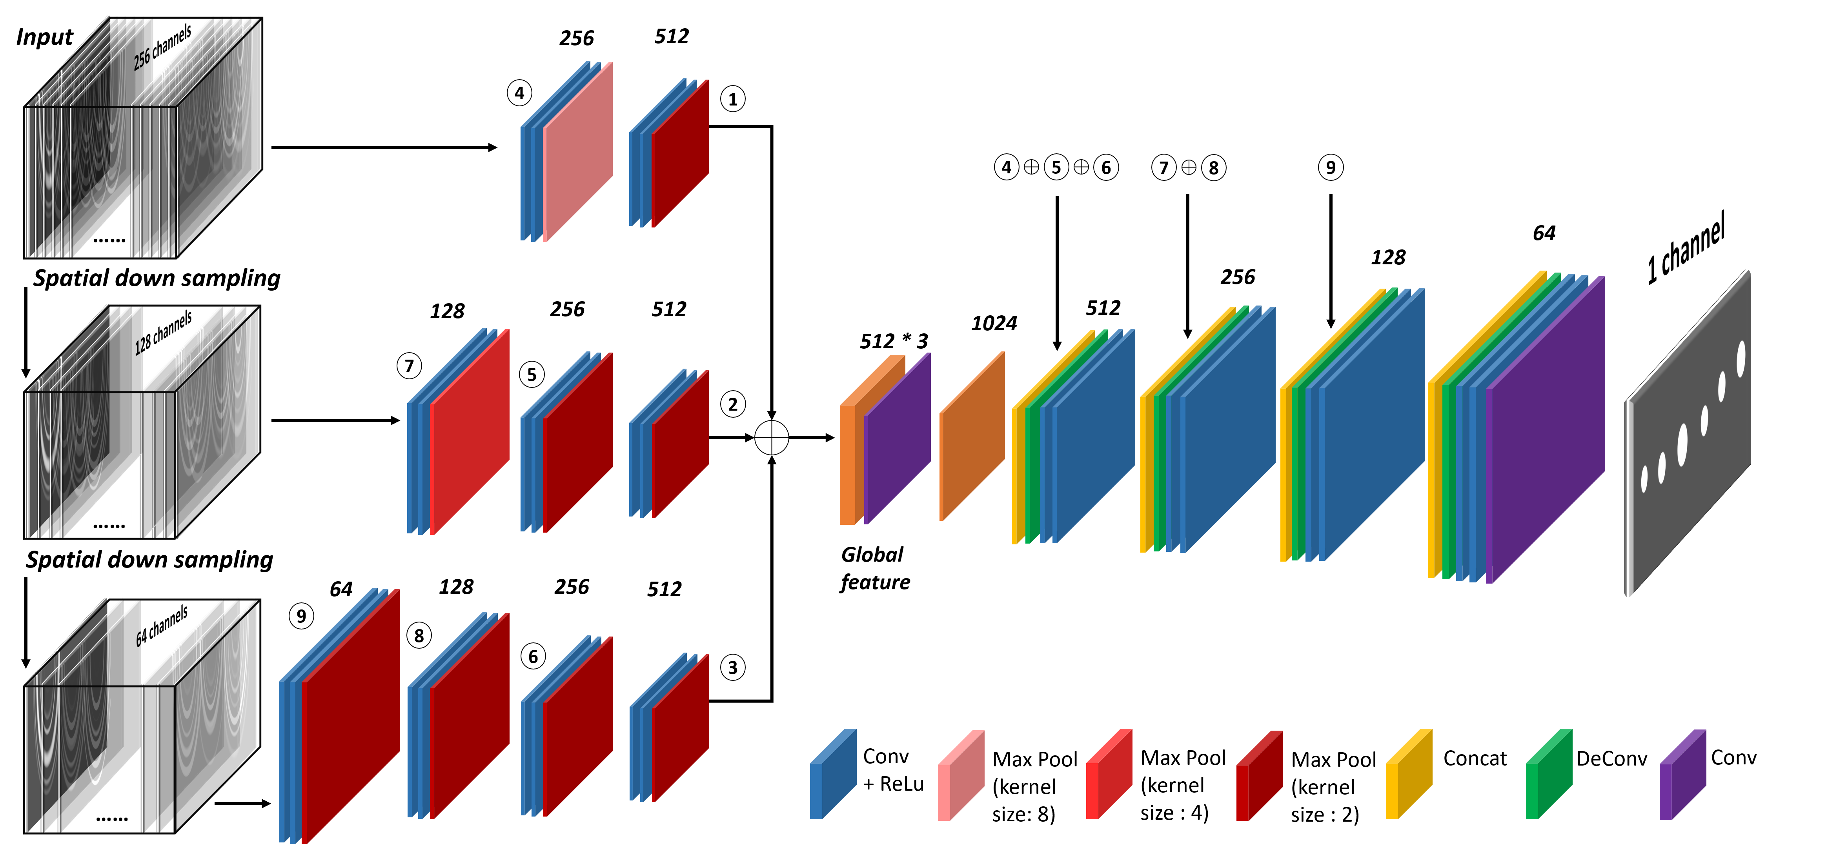
MigrationNet Architecture
Model Design
Inspired by [1]
up-sampling group
each group contains two convolutional layers and one deconvolutional layer
256 channels input data, and further down-sampling into 128 and 64 channels in spatial domain.
⊕ represents the skip connection while ①-⑨ indicate each last encoder layer
Multiple Spatial Resolution Encoder (MSRE)
[1] Lin, Tsung-Yi, et al. "Feature pyramid networks for object detection." Proceedings of the IEEE conference on computer vision and pattern recognition. 2017.

Slide 9
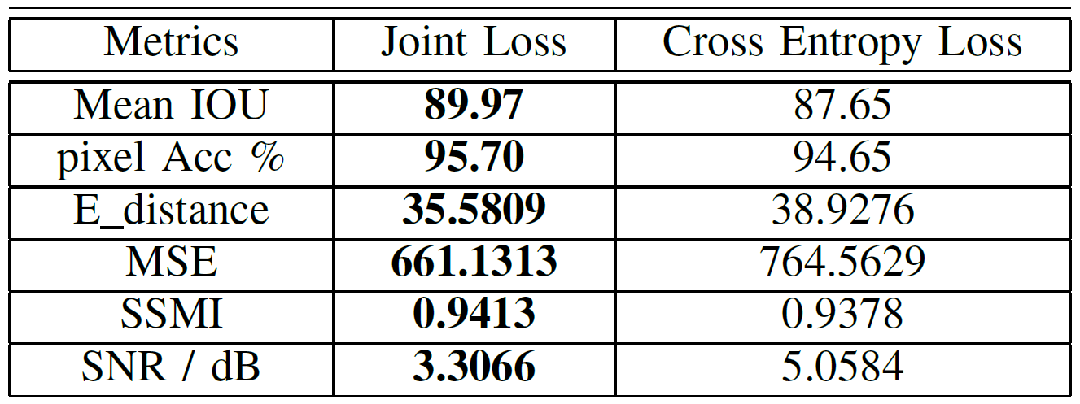
Loss Design
Similarity matters!!
$$σ_{xy}=\frac{1}{N−1}\sum_{i=1}^{N}{\left(x_{i}−μ_{x}\right)\left(y_{i}−μ_{y}\right)}$$
$$L_{1}=\frac{σ_{xy}+C}{σ_{x}σ_{y}+C}$$
$σ_{x} σ_{y}$are standard deviations as an estimation of image contrast respectively.
Loss Design
Inspired by [2]
$$L=λ_{i}L_{1}+λ_{j}L_{2}$$
$x$ is the predicted image while $y$ is the ground truth image.
$$L_{2}=\sum_{x_{i}∈ℳ}{w^{j}\left(x\right)log\left(p\left(x_{i,j}\right)\right)}$$
$$Table 1$$
Loss Performance Comparison
[2] Zhou Wang, Alan C Bovik, Hamid R Sheikh, and Eero P Si-moncelli. Image quality assessment: from error visibility to structural similarity. IEEE transactions on image processing,13(4):600–612, 2004.

Slide 10
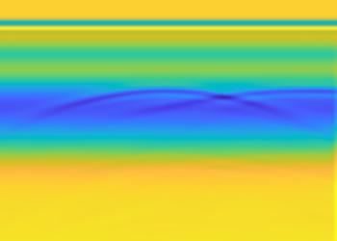
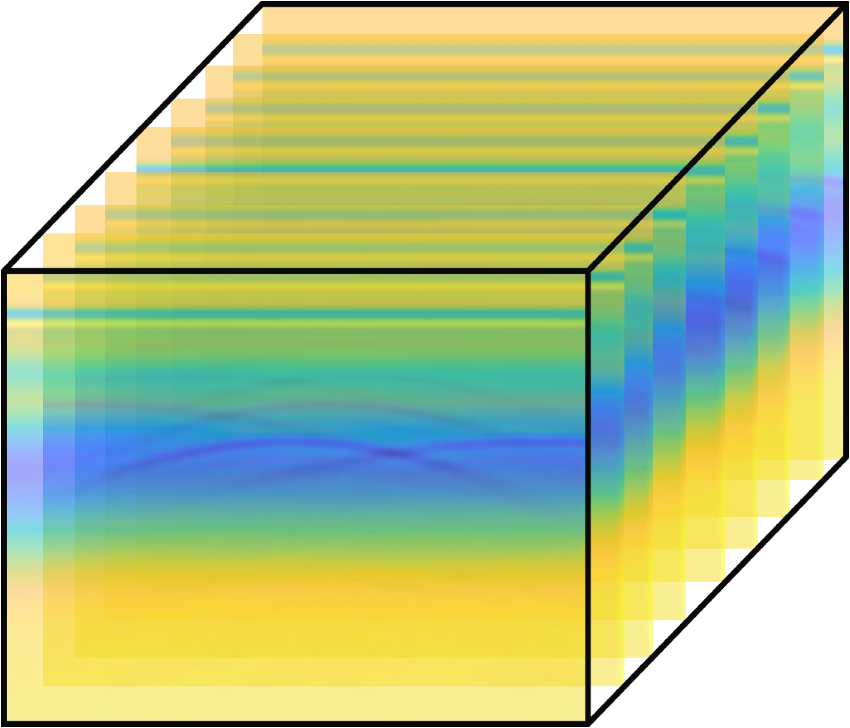
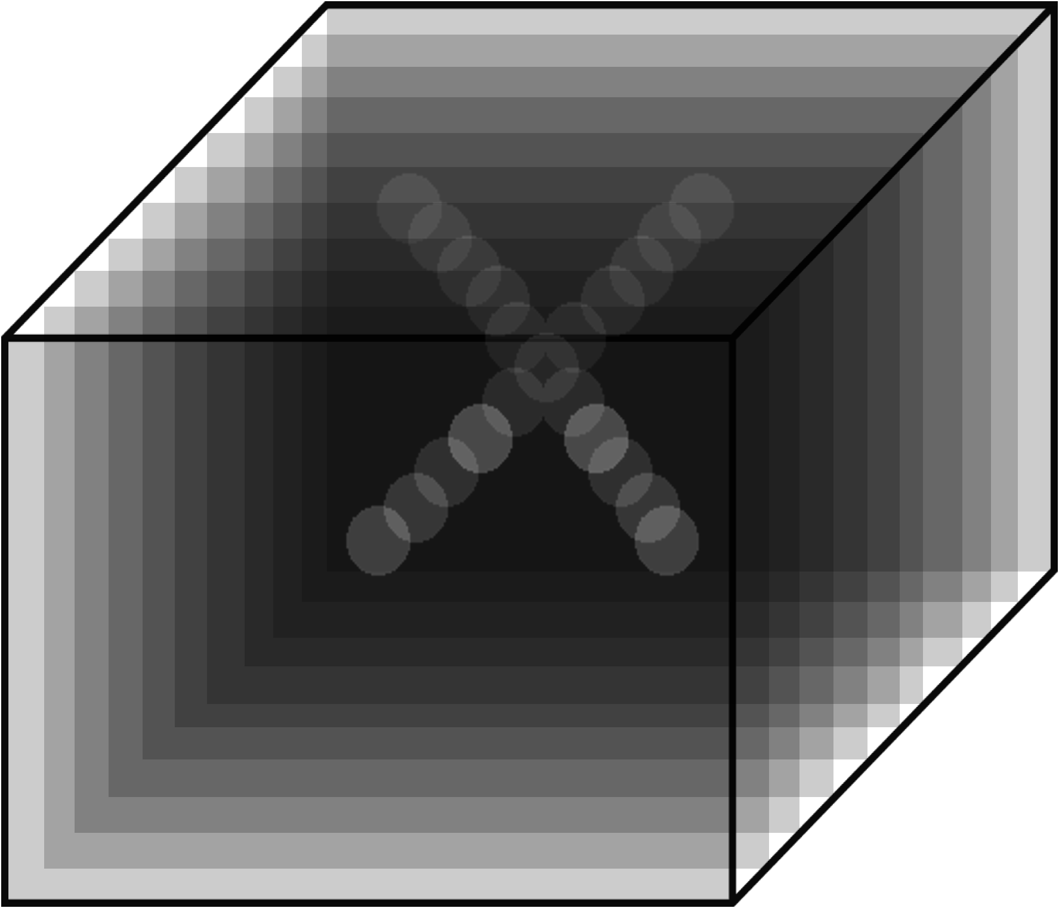
3D Subsurface Modelling -- Motivation
MigrationNet
Challenge: A 2D reconstruction is not able to reveal the subsurface targets
？
We need to obtain 3D underground objects reconstruction

Slide 11
Data Setup and 3D Registration
We use gprMax [3] create a new dataset which contains both
synthetic and field GPR / point cloud data
 | Synthetic Data | Field Data
Test Models | 137 | 1
GPR B-scan Data | 1507 | 1 * 120
Point Cloud Data | 685 | 12
Input
Ground
Truth
We use MigrationNet to firstly obtain the 2D cross-section images, then register them into the 3D domain
[3] Warren, Craig, Antonios Giannopoulos, and Iraklis Giannakis. "gprMax: Open source software to simulate electromagnetic wave propagation for Ground Penetrating Radar." Computer Physics Communications 209 (2016): 163-170.

Slide 12
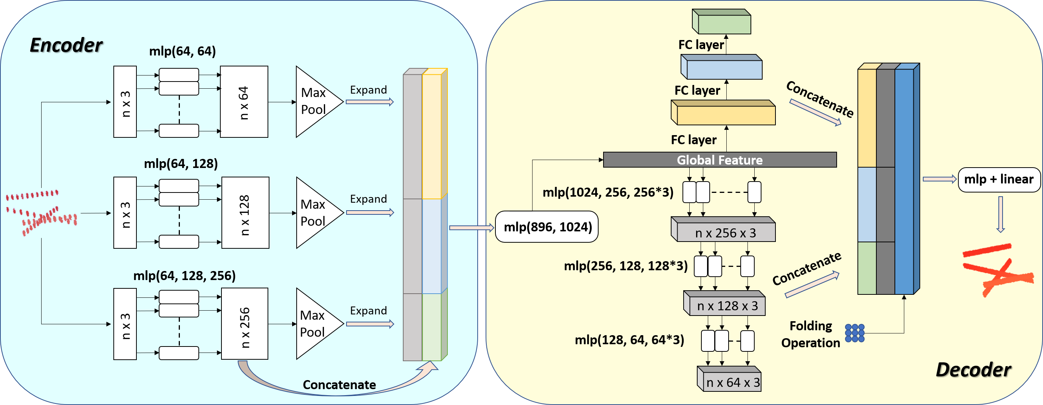
GPRNet Architecture
Encoder Strength [4]: could extract multiple resolution information of the input data, which leads a better performance on small structure completion.
Decoder Strength [5]: 1) good at predicting the global geometry of point cloud; 2) good at generating a smooth local feature
[4] W. Yuan, T. Khot, D. Held, C. Mertz, and M. Hebert, “Pcn: Point completion network,” in2018 International Conference on 3D Vision(3DV). IEEE, 2018, pp. 728–737.
[5] Z. Huang, Y. Yu, J. Xu, F. Ni, and X. Le, “Pf-net: Point fractal network for 3d point cloud completion,” in Proceedings of the IEEE/CVF Conference on Computer Vision and Pattern Recognition, 2020, pp.7662–7670

Slide 13
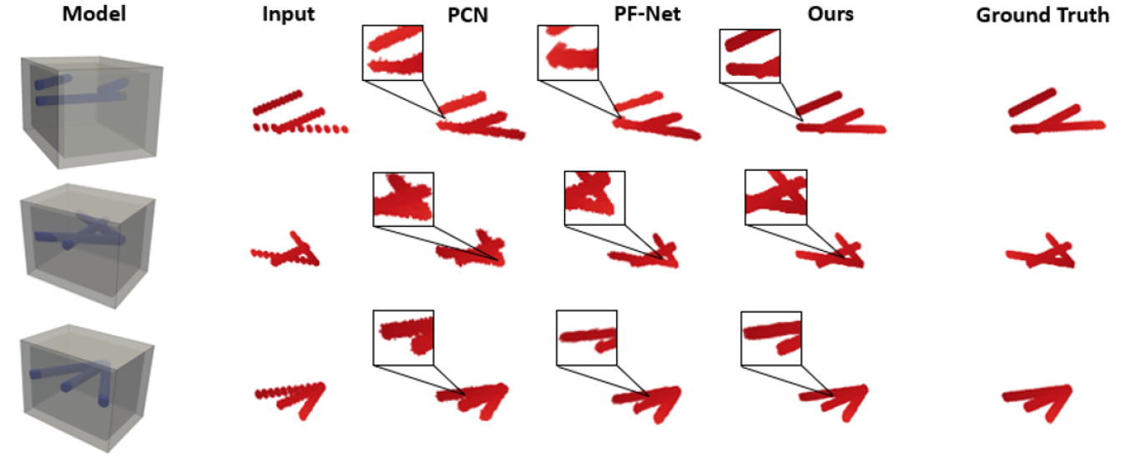
Subsurface Modelling Results – Synthetic Data

Slide 14
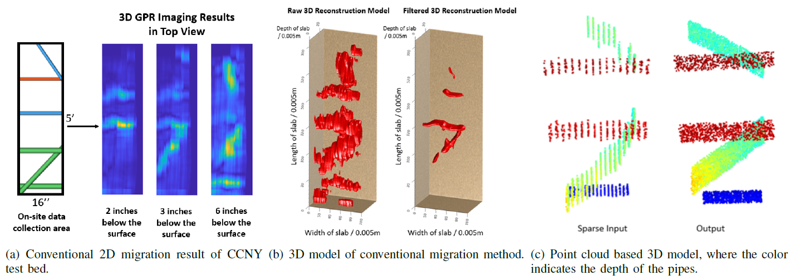
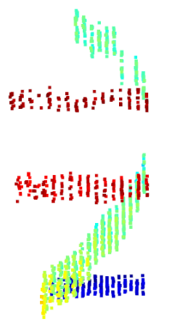
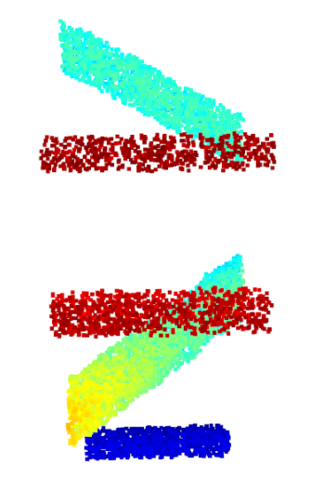
Subsurface Modelling Results – Field Data

Slide 15
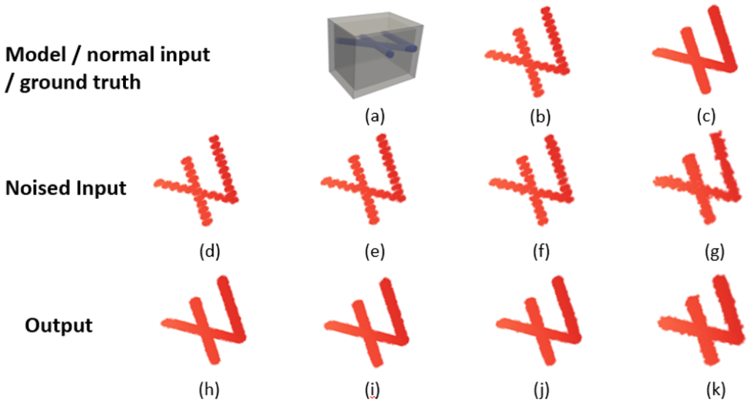
Other Subsurface Modelling Results
$$Noise Comparison$$
$$Incompleteness Comparison$$

Slide 16
$$Thank you!$$
&
Questions

